Slide 1
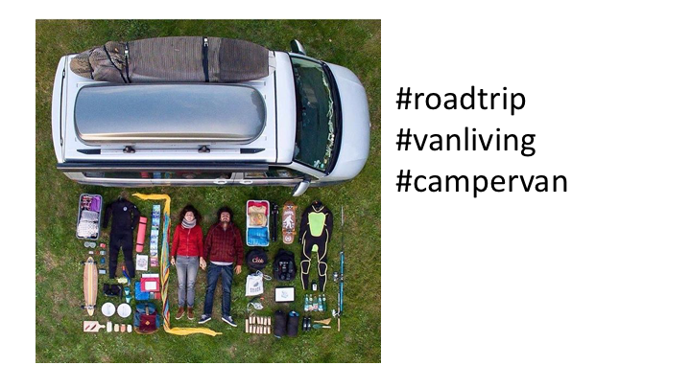

Slide 2
Yes
Notes:
C:\code\hashtag_deck\sparrowgram\Discoverable 01.png

Slide 3
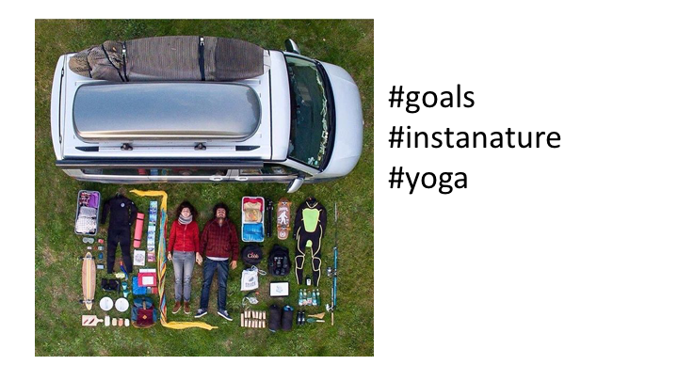

Slide 4
No
Notes:
C:\code\hashtag_deck\sparrowgram\Meh 01.png

Slide 5
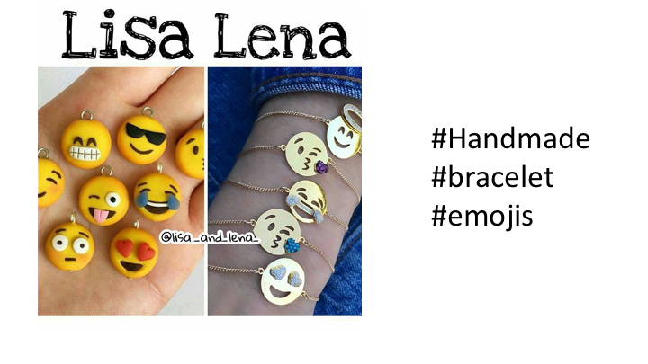

Slide 6
Yes
Notes:
C:\code\hashtag_deck\sparrowgram\Discoverable 02.png

Slide 7
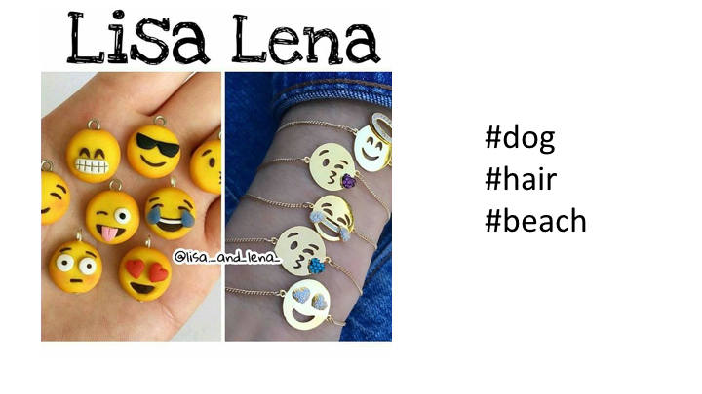

Slide 8
No
Notes:
C:\code\hashtag_deck\sparrowgram\Meh 02.png

Slide 9
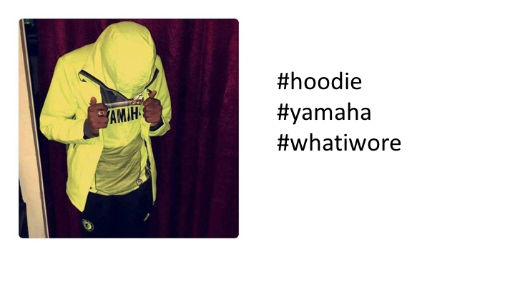

Slide 10
Yes
Notes:
C:\code\hashtag_deck\sparrowgram\Discoverable 03.png

Slide 11
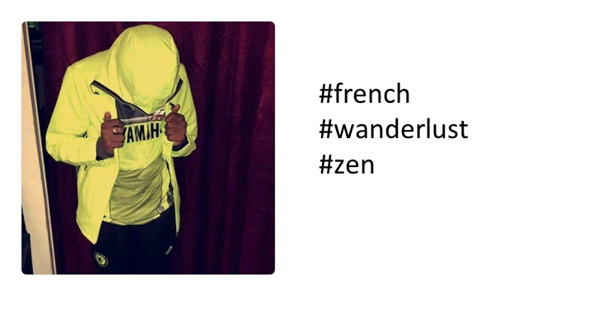

Slide 12
No
Notes:
C:\code\hashtag_deck\sparrowgram\Meh 03.png

Slide 13
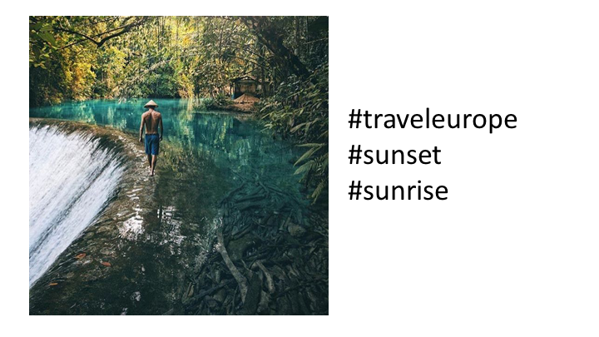

Slide 14
No
Notes:
C:\code\hashtag_deck\sparrowgram\Meh 04.png

Slide 15
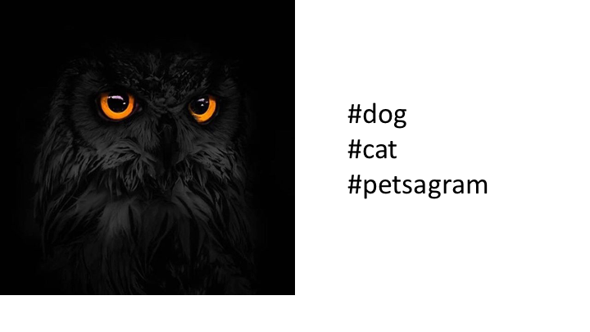

Slide 16
No
Notes:
C:\code\hashtag_deck\sparrowgram\Meh 05.png

Slide 17
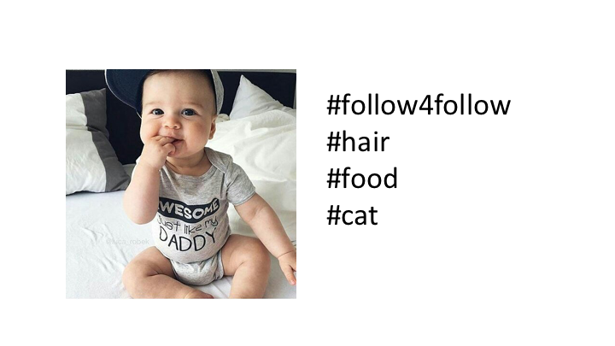

Slide 18
No
Notes:
C:\code\hashtag_deck\sparrowgram\Meh 06.png

Slide 19
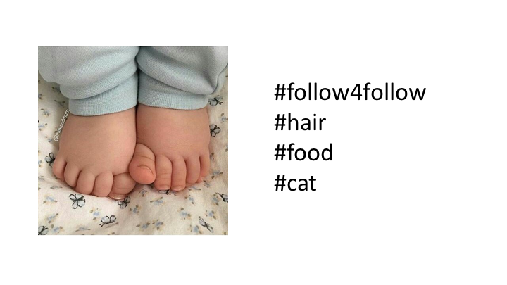

Slide 20
No
Notes:
C:\code\hashtag_deck\sparrowgram\Meh 07.png

Slide 21
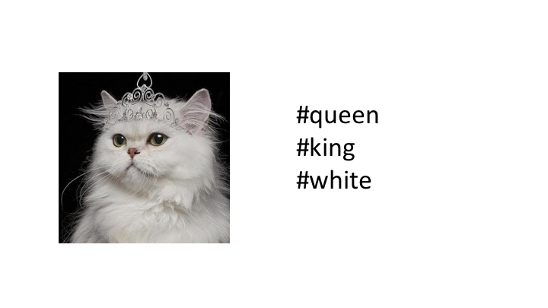

Slide 22
No
Notes:
C:\code\hashtag_deck\sparrowgram\Meh 08.png

Slide 23
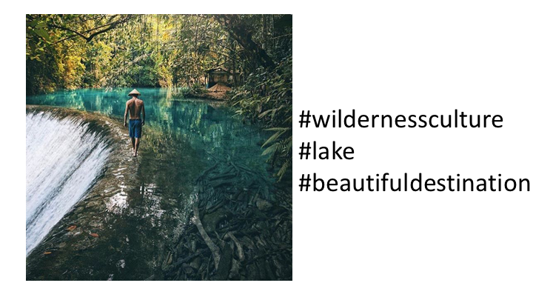

Slide 24
Yes
Notes:
C:\code\hashtag_deck\sparrowgram\Discoverable 04.png

Slide 25
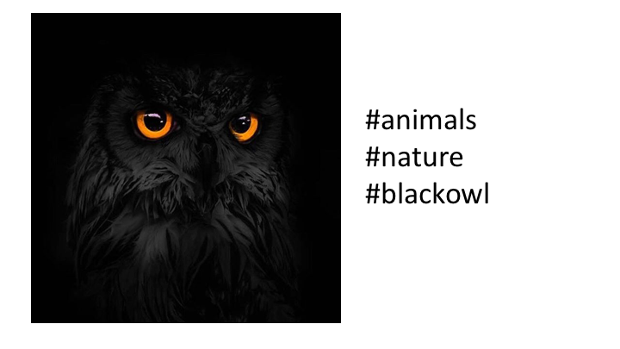

Slide 26
Yes
Notes:
C:\code\hashtag_deck\sparrowgram\Discoverable 05.png

Slide 27
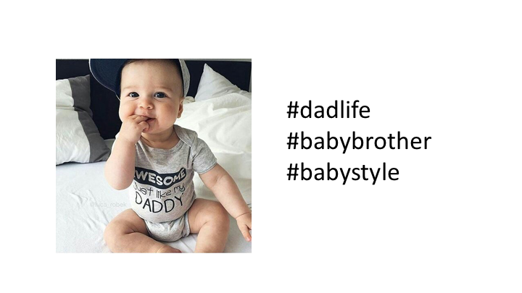

Slide 28
Yes
Notes:
C:\code\hashtag_deck\sparrowgram\Discoverable 06.png

Slide 29
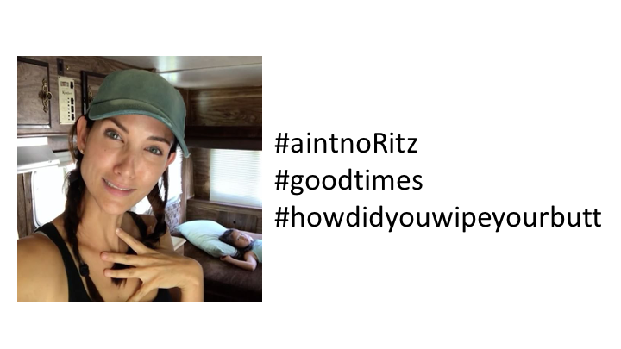

Slide 30
No
Notes:
C:\code\hashtag_deck\sparrowgram\Meh 09.png

Slide 31
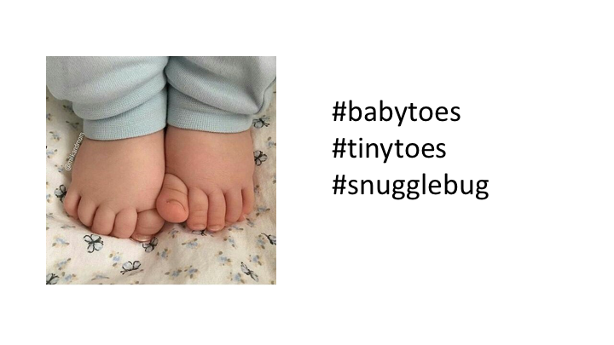

Slide 32
Yes
Notes:
C:\code\hashtag_deck\sparrowgram\Discoverable 07.png

Slide 33
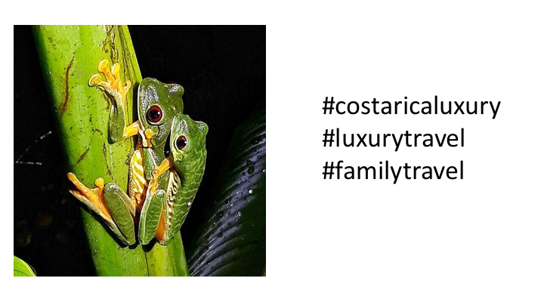

Slide 34
No
Notes:
C:\code\hashtag_deck\sparrowgram\Meh 10.png

Slide 35
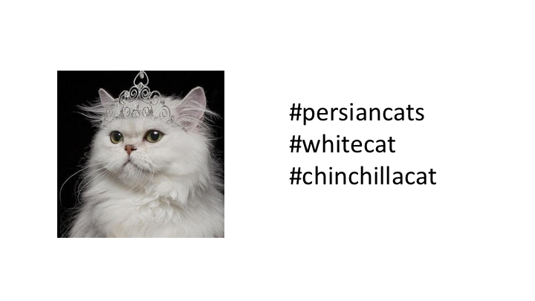

Slide 36
Yes
Notes:
C:\code\hashtag_deck\sparrowgram\Discoverable 08.png

Slide 37


Slide 38
Yes
Notes:
C:\code\hashtag_deck\sparrowgram\Discoverable 09.png

Slide 39
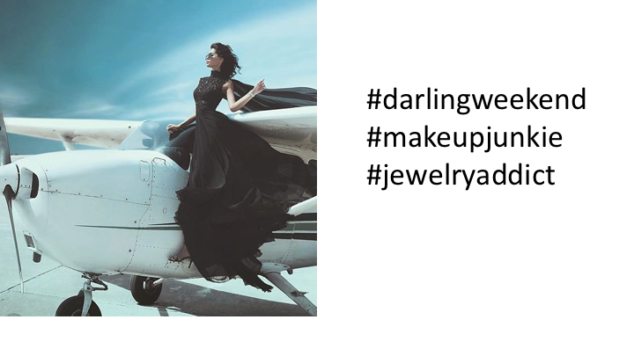

Slide 40
No
Notes:
C:\code\hashtag_deck\sparrowgram\Meh 11.png

Slide 41
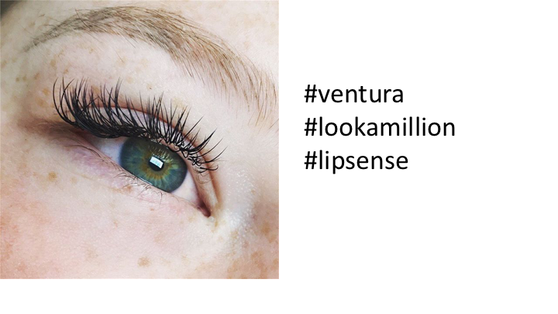

Slide 42
No
Notes:
C:\code\hashtag_deck\sparrowgram\Meh 12.png

Slide 43
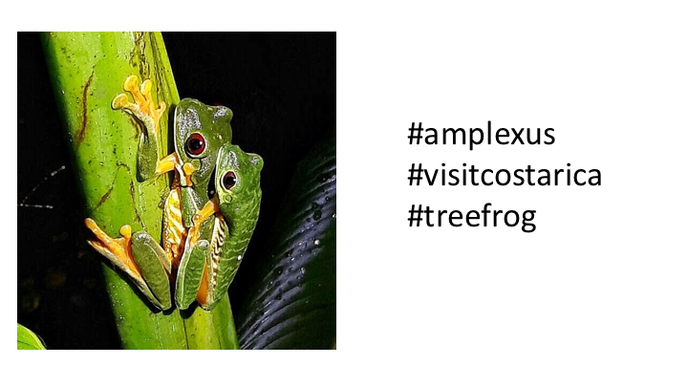

Slide 44
Yes
Notes:
C:\code\hashtag_deck\sparrowgram\Discoverable 10.png

Slide 45


Slide 46
Yes
Notes:
C:\code\hashtag_deck\sparrowgram\Discoverable 11.png

Slide 47


Slide 48
Yes
Notes:
C:\code\hashtag_deck\sparrowgram\Discoverable 12.png

Slide 49
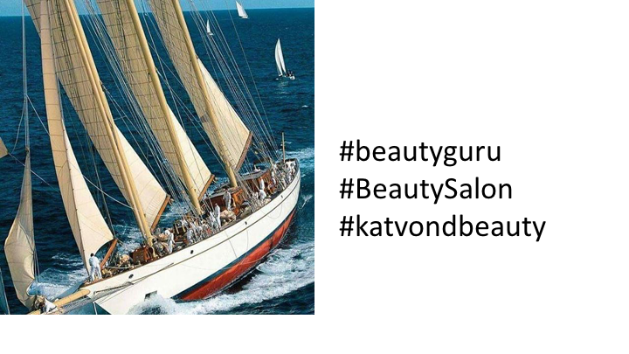

Slide 50
No
Notes:
C:\code\hashtag_deck\sparrowgram\Meh 13.png

Slide 51
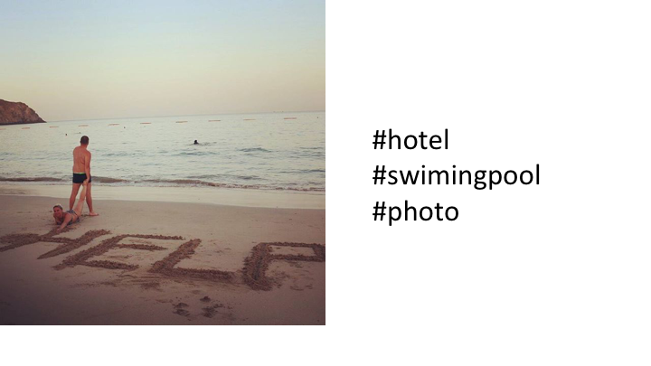

Slide 52
No
Notes:
C:\code\hashtag_deck\sparrowgram\Meh 14.png

Slide 53
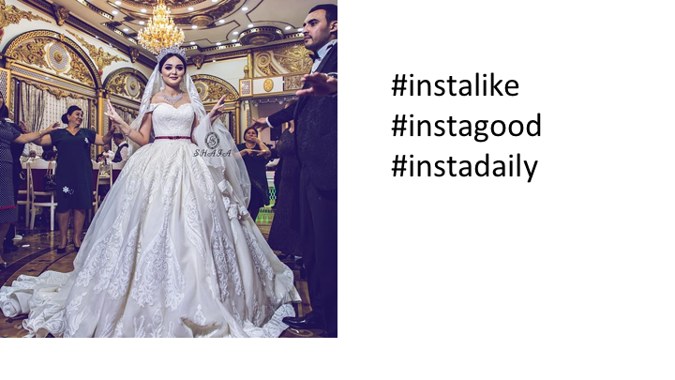

Slide 54
No
Notes:
C:\code\hashtag_deck\sparrowgram\Meh 15.png

Slide 55
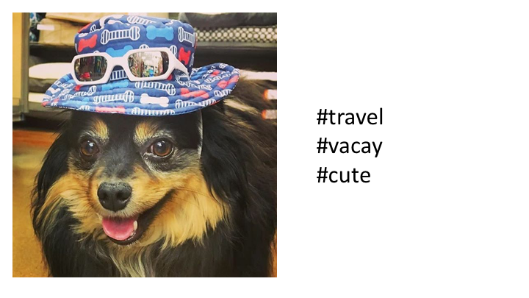

Slide 56
No
Notes:
C:\code\hashtag_deck\sparrowgram\Meh 16.png

Slide 57
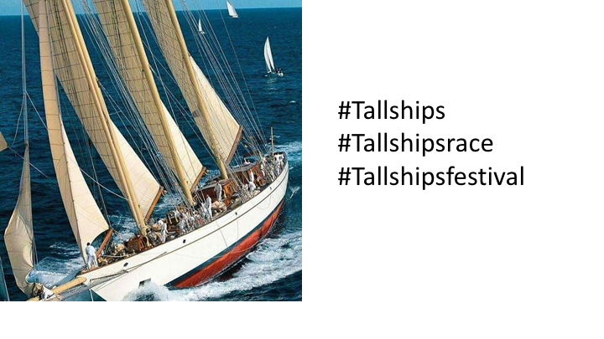

Slide 58
Yes
Notes:
C:\code\hashtag_deck\sparrowgram\Discoverable 13.png

Slide 59
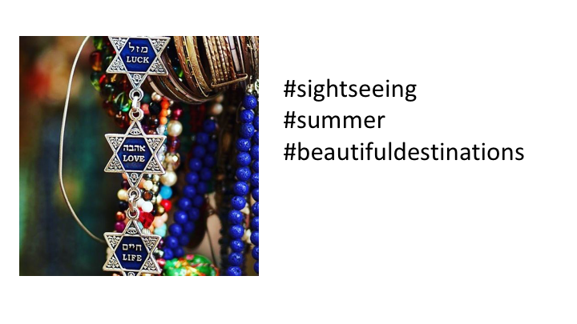

Slide 60
No
Notes:
C:\code\hashtag_deck\sparrowgram\Meh 17.png

Slide 61
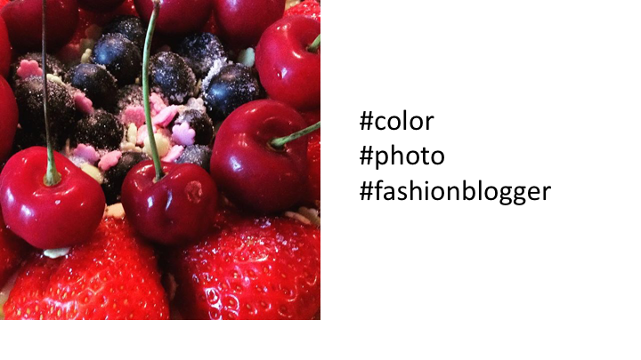

Slide 62
No
Notes:
C:\code\hashtag_deck\sparrowgram\Meh 18.png

Slide 63
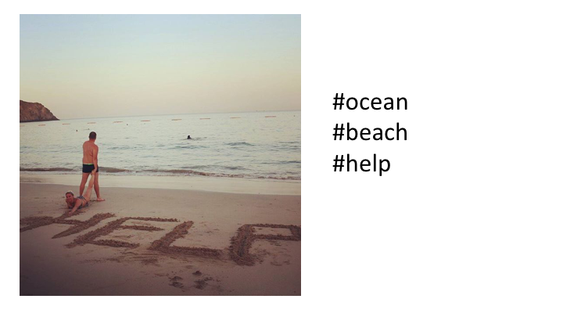

Slide 64
Yes
Notes:
C:\code\hashtag_deck\sparrowgram\Discoverable 14.png

Slide 65
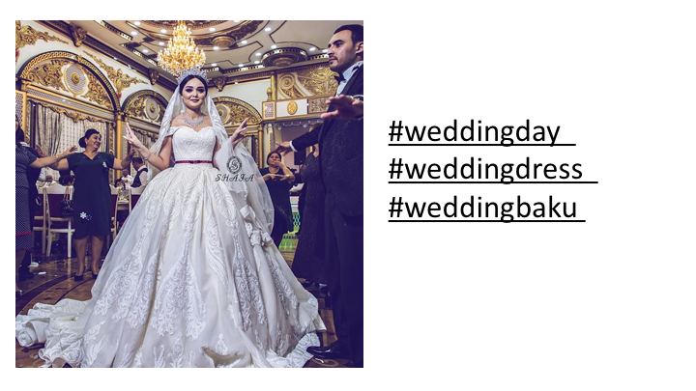

Slide 66
Yes
Notes:
C:\code\hashtag_deck\sparrowgram\Discoverable 15.png

Slide 67


Slide 68
No
Notes:
C:\code\hashtag_deck\sparrowgram\Meh 19.png

Slide 69
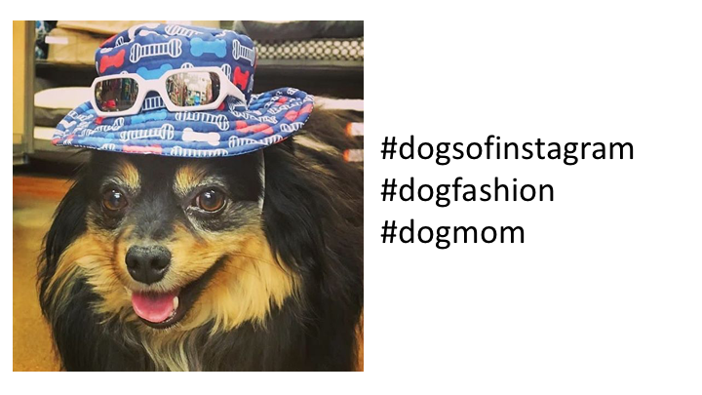

Slide 70
Yes
Notes:
C:\code\hashtag_deck\sparrowgram\Discoverable 16.png

Slide 71
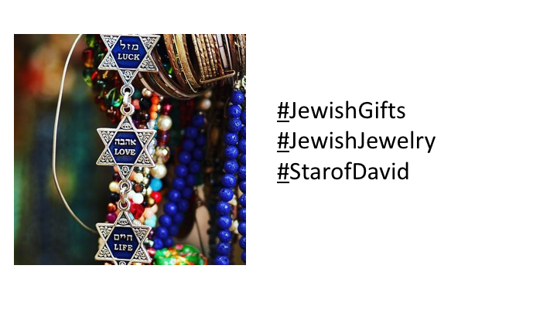

Slide 72
Yes
Notes:
C:\code\hashtag_deck\sparrowgram\Discoverable 17.png

Slide 73
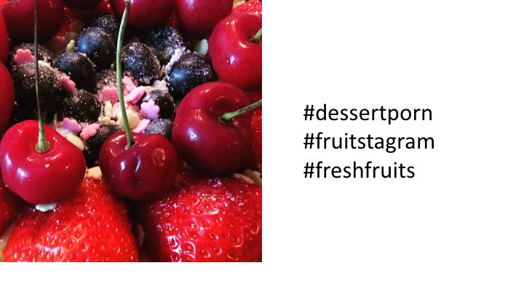

Slide 74
Yes
Notes:
C:\code\hashtag_deck\sparrowgram\Discoverable 18.png

Slide 75


Slide 76
No
Notes:
C:\code\hashtag_deck\sparrowgram\Meh 20.png

Slide 77


Slide 78
Yes
Notes:
C:\code\hashtag_deck\sparrowgram\Discoverable 19.png

Slide 79
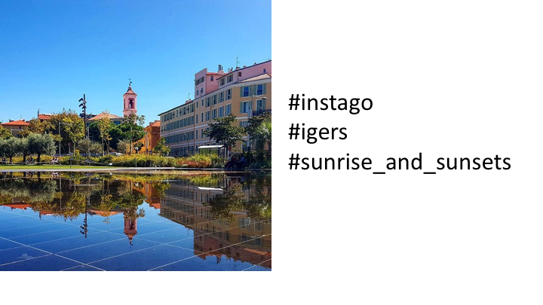

Slide 80
No
Notes:
C:\code\hashtag_deck\sparrowgram\Meh 21.png

Slide 81
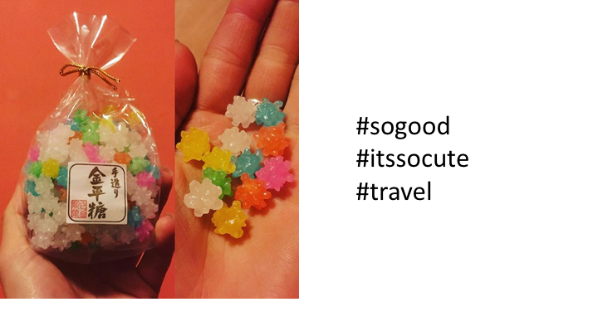

Slide 82
No
Notes:
C:\code\hashtag_deck\sparrowgram\Meh 22.png

Slide 83
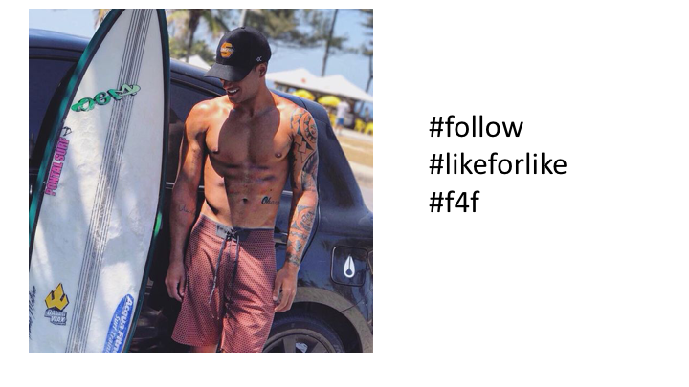

Slide 84
No
Notes:
C:\code\hashtag_deck\sparrowgram\Meh 23.png

Slide 85


Slide 86
Yes
Notes:
C:\code\hashtag_deck\sparrowgram\Discoverable 20.png

Slide 87
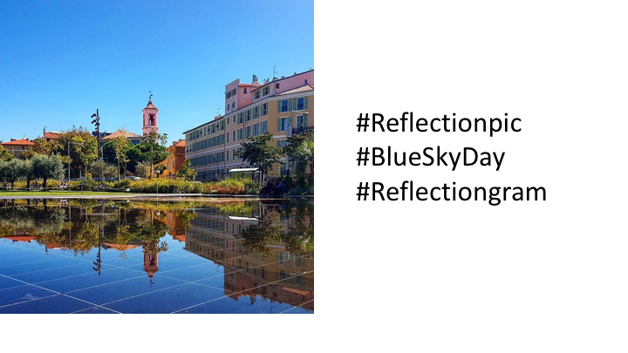

Slide 88
Yes
Notes:
C:\code\hashtag_deck\sparrowgram\Discoverable 21.png

Slide 89
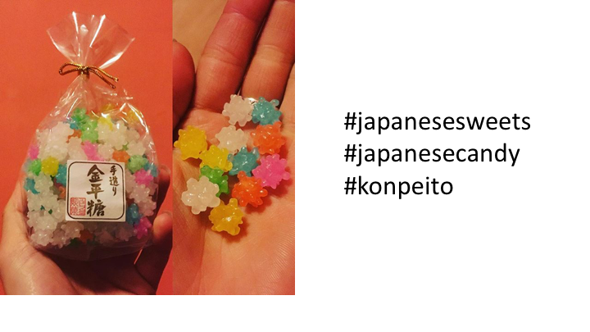

Slide 90
Yes
Notes:
C:\code\hashtag_deck\sparrowgram\Discoverable 22.png

Slide 91


Slide 92
Yes
Notes:
C:\code\hashtag_deck\sparrowgram\Discoverable 23.png

Slide 93


Slide 94
Yes
Notes:
C:\code\hashtag_deck\sparrowgram\Discoverable 24.png

Slide 95
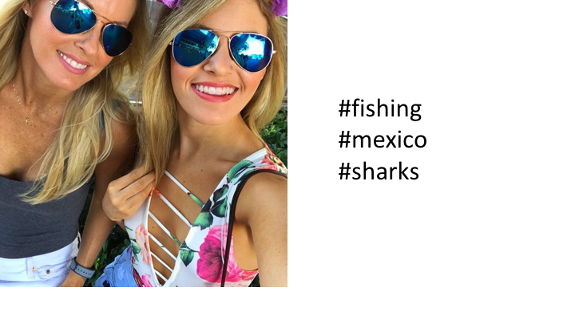

Slide 96
No
Notes:
C:\code\hashtag_deck\sparrowgram\Meh 24.png

Slide 97


Slide 98
No
Notes:
C:\code\hashtag_deck\sparrowgram\Meh 25.png

Slide 99
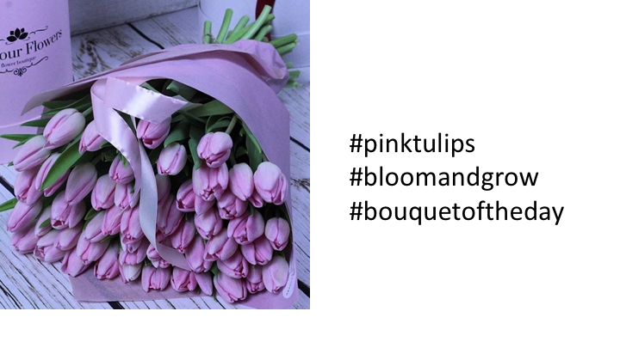

Slide 100
Yes
Notes:
C:\code\hashtag_deck\sparrowgram\Discoverable 25.png

Slide 101
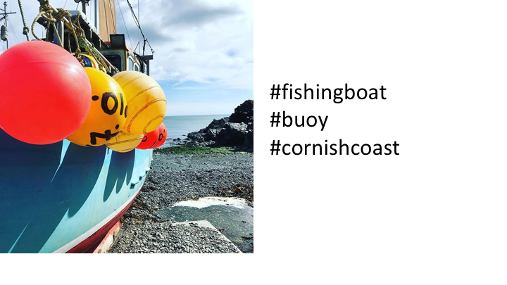

Slide 102
Yes
Notes:
C:\code\hashtag_deck\sparrowgram\Discoverable 26.png

Slide 103
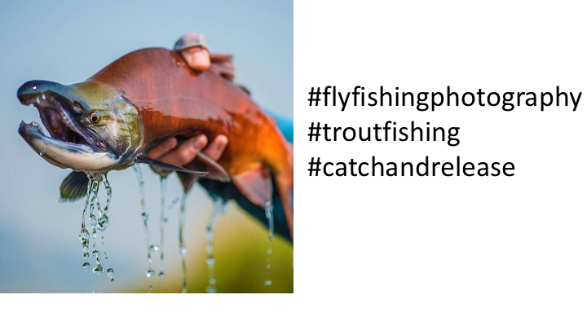

Slide 104
Yes
Notes:
C:\code\hashtag_deck\sparrowgram\Discoverable 27.png

Slide 105
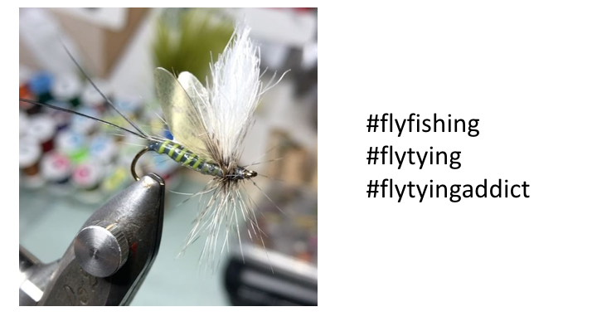

Slide 106
Yes
Notes:
C:\code\hashtag_deck\sparrowgram\Discoverable 28.png

Slide 107
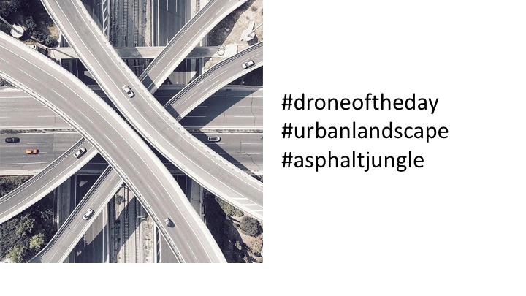

Slide 108
Yes
Notes:
C:\code\hashtag_deck\sparrowgram\Discoverable 29.png

Slide 109
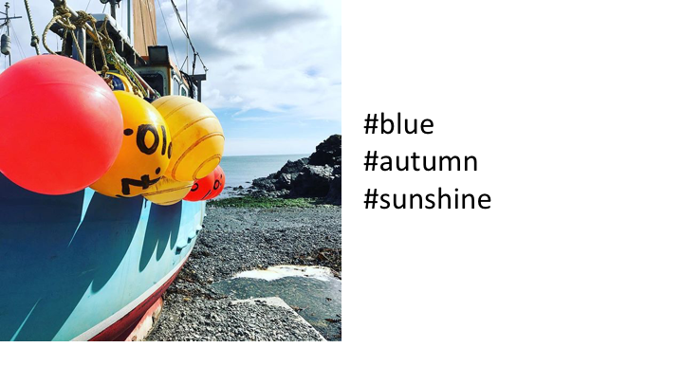

Slide 110
No
Notes:
C:\code\hashtag_deck\sparrowgram\Meh 26.png

Slide 111
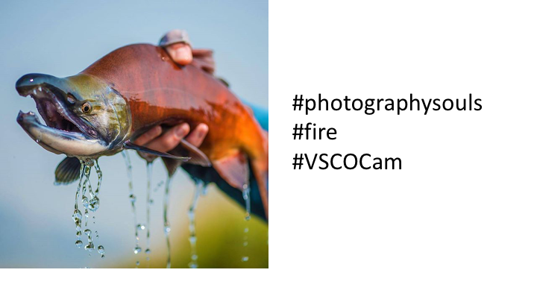

Slide 112
No
Notes:
C:\code\hashtag_deck\sparrowgram\Meh 27.png

Slide 113
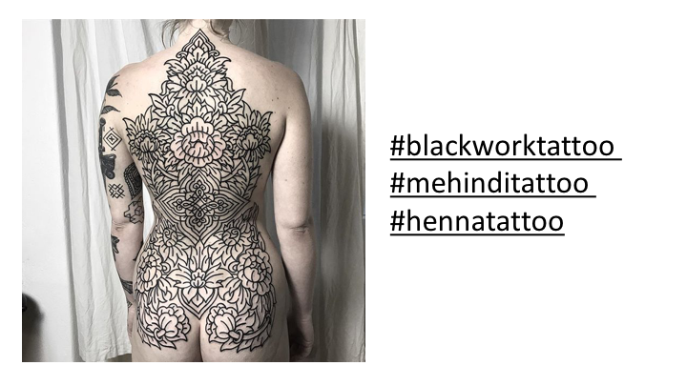

Slide 114
Yes
Notes:
C:\code\hashtag_deck\sparrowgram\Discoverable 30.png

Slide 115
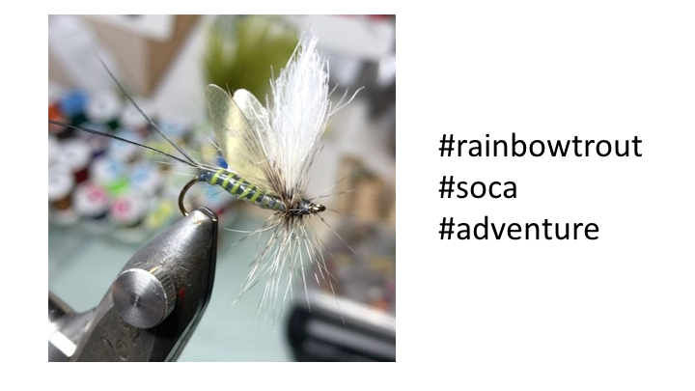

Slide 116
No
Notes:
C:\code\hashtag_deck\sparrowgram\Meh 28.png

Slide 117
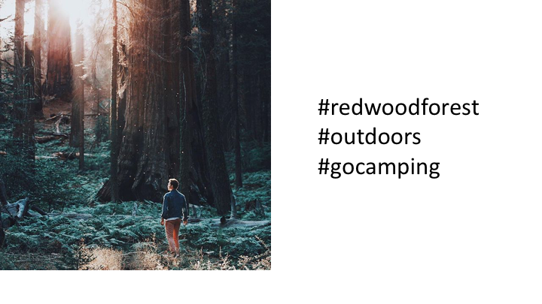

Slide 118
Yes
Notes:
C:\code\hashtag_deck\sparrowgram\Discoverable 31.png

Slide 119
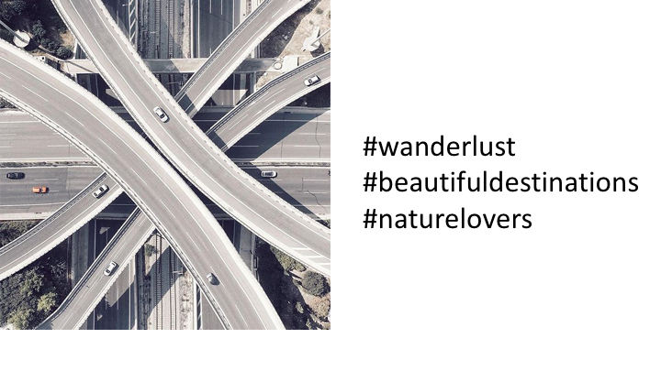

Slide 120
No
Notes:
C:\code\hashtag_deck\sparrowgram\Meh 29.png

Slide 121


Slide 122
No
Notes:
C:\code\hashtag_deck\sparrowgram\Meh 30.png

Slide 123


Slide 124
No
Notes:
C:\code\hashtag_deck\sparrowgram\Meh 31.png

Slide 125


Slide 126
Yes
Notes:
C:\code\hashtag_deck\sparrowgram\Discoverable 32.png

Slide 127


Slide 128
Yes
Notes:
C:\code\hashtag_deck\sparrowgram\Discoverable 33.png

Slide 129


Slide 130
Yes
Notes:
C:\code\hashtag_deck\sparrowgram\Discoverable 34.png

Slide 131


Slide 132
Yes
Notes:
C:\code\hashtag_deck\sparrowgram\Discoverable 35.png

Slide 133


Slide 134
No
Notes:
C:\code\hashtag_deck\sparrowgram\Meh 32.png

Slide 135


Slide 136
No
Notes:
C:\code\hashtag_deck\sparrowgram\Meh 33.png

Slide 137


Slide 138
Yes
Notes:
C:\code\hashtag_deck\sparrowgram\Discoverable 36.png

Slide 139


Slide 140
No
Notes:
C:\code\hashtag_deck\sparrowgram\Meh 34.png

Slide 141


Slide 142
No
Notes:
C:\code\hashtag_deck\sparrowgram\Meh 35.png

Slide 143


Slide 144
No
Notes:
C:\code\hashtag_deck\sparrowgram\Meh 36.png

Slide 145


Slide 146
No
Notes:
C:\code\hashtag_deck\sparrowgram\Meh 37.png

Slide 147


Slide 148
Yes
Notes:
C:\code\hashtag_deck\sparrowgram\Discoverable 37.png

Slide 149


Slide 150
No
Notes:
C:\code\hashtag_deck\sparrowgram\Meh 38.png

Slide 151


Slide 152
No
Notes:
C:\code\hashtag_deck\sparrowgram\Meh 39.png

Slide 153


Slide 154
No
Notes:
C:\code\hashtag_deck\sparrowgram\Meh 40.png

Slide 155


Slide 156
No
Notes:
C:\code\hashtag_deck\sparrowgram\Meh 41.png

Slide 157


Slide 158
Yes
Notes:
C:\code\hashtag_deck\sparrowgram\Discoverable 38.png

Slide 159


Slide 160
No
Notes:
C:\code\hashtag_deck\sparrowgram\Meh 42.png

Slide 161


Slide 162
No
Notes:
C:\code\hashtag_deck\sparrowgram\Meh 43.png

Slide 163


Slide 164
Yes
Notes:
C:\code\hashtag_deck\sparrowgram\Discoverable 39.png

Slide 165


Slide 166
No
Notes:
C:\code\hashtag_deck\sparrowgram\Meh 44.png

Slide 167


Slide 168
Yes
Notes:
C:\code\hashtag_deck\sparrowgram\Discoverable 40.png

Slide 169


Slide 170
No
Notes:
C:\code\hashtag_deck\sparrowgram\Meh 45.png

Slide 171


Slide 172
Yes
Notes:
C:\code\hashtag_deck\sparrowgram\Discoverable 41.png

Slide 173


Slide 174
Yes
Notes:
C:\code\hashtag_deck\sparrowgram\Discoverable 42.png

Slide 175


Slide 176
Yes
Notes:
C:\code\hashtag_deck\sparrowgram\Discoverable 43.png

Slide 177


Slide 178
No
Notes:
C:\code\hashtag_deck\sparrowgram\Meh 46.png

Slide 179


Slide 180
No
Notes:
C:\code\hashtag_deck\sparrowgram\Meh 47.png

Slide 181


Slide 182
No
Notes:
C:\code\hashtag_deck\sparrowgram\Meh 48.png

Slide 183


Slide 184
Yes
Notes:
C:\code\hashtag_deck\sparrowgram\Discoverable 44.png

Slide 185


Slide 186
No
Notes:
C:\code\hashtag_deck\sparrowgram\Meh 49.png

Slide 187


Slide 188
No
Notes:
C:\code\hashtag_deck\sparrowgram\Meh 50.png

Slide 189


Slide 190
Yes
Notes:
C:\code\hashtag_deck\sparrowgram\Discoverable 45.png

Slide 191


Slide 192
Yes
Notes:
C:\code\hashtag_deck\sparrowgram\Discoverable 46.png

Slide 193


Slide 194
Yes
Notes:
C:\code\hashtag_deck\sparrowgram\Discoverable 48.png

Slide 195


Slide 196
Yes
Notes:
C:\code\hashtag_deck\sparrowgram\Discoverable 49.png

Slide 197


Slide 198
Yes
Notes:
C:\code\hashtag_deck\sparrowgram\Discoverable 50.png

Slide 199


Slide 200
Yes
Notes:
C:\code\hashtag_deck\sparrowgram\Discoverable 51.png

